Slide 1
Time Series
ARMA MODEL : Basic concept

Slide 2

Time Series: Definition
A stochastic process is a collection of random variables $\left\{X_{t}, t∈T\right\}$, defined on a probability space $\left(Ω, F, P\right)$.
A time series is a stochastic process in which $T$ is a set of time points, usually
$$T=\left\{0, ±1, ±2, .. .\right\}, \left\{1, 2, 3, .. .\right\}, \left[0,\left.∞\right), \text{or} \left(−∞, ∞\right)\right.$$
Note: The term “time series” is also used to refer to the realization of such a process (observed time series).

Slide 3

Time Series: Stationarity
The auto-covariance function of a time series $\left\{X_{t}, t∈ℤ\right\}$:
$γ_{X}\left(r, s\right)=Ε\left[\left(X_{γ}−Ε\left[X_{γ}\right]\right)∙\left(X_{s}−Ε\left[X_{s}\right]\right)\right].$
$\left\{X_{t}\right\}$ is (weakly) stationary if
$Ε\left[{X_{t}}^{2}\right]<∞$ for all $t∈ℤ$,
$Ε\left[X_{t}\right]=μ$ for all $t∈ℤ$, and
$γ_{X}\left(r, s\right)=$ $γ_{X}\left(r+t, s+t\right)$ for all $r, s, t∈ℤ$.

Slide 4
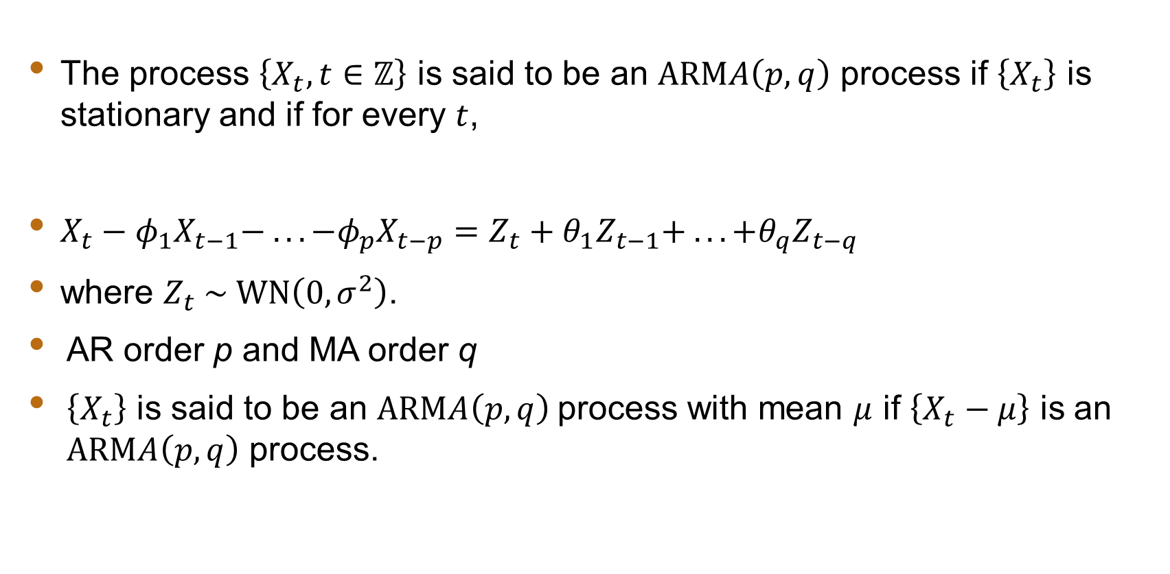
ARMA Model: Definition
The process $\left\{X_{t}, t∈ℤ\right\}$ is said to be an $\text{ARM}A\left(p, q\right)$ process if $\left\{X_{t}\right\}$ is stationary and if for every $t$,
$X_{t}−φ_{1}X_{t−1}− .. . −φ_{p}X_{t−p}=Z_{t}+θ_{1}Z_{t−1}+ .. . +θ_{q}Z_{t−q}$
where $Z_{t} \sim \text{WN}\left(0, σ^{2}\right)$.
AR order p and MA order q
$\left\{X_{t}\right\}$ is said to be an $\text{ARM}A\left(p, q\right)$process with mean $μ$ if $\left\{X_{t}−μ\right\}$ is an $\text{ARM}A\left(p, q\right)$ process.

Slide 5
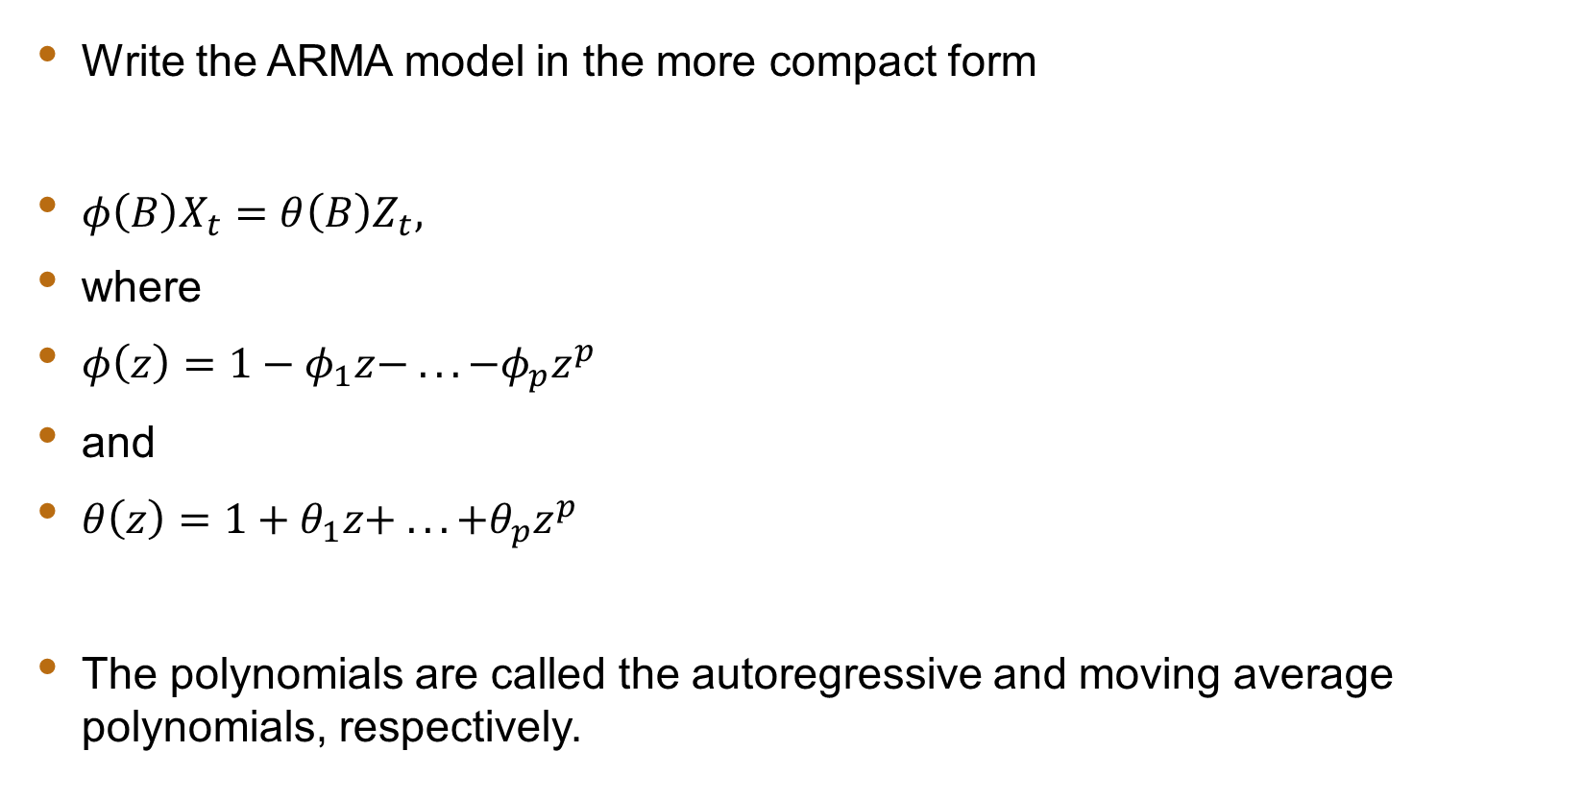
ARMA Model: Notation
Write the ARMA model in the more compact form
$φ\left(B\right)X_{t}=θ\left(B\right)Z_{t},$
where
$φ\left(z\right)=1−φ_{1}z− .. . −φ_{p}z^{p}$
and
$θ\left(z\right)=1+θ_{1}z+ .. . +θ_{p}z^{p}$
The polynomials are called the autoregressive and moving average polynomials, respectively.

Slide 6
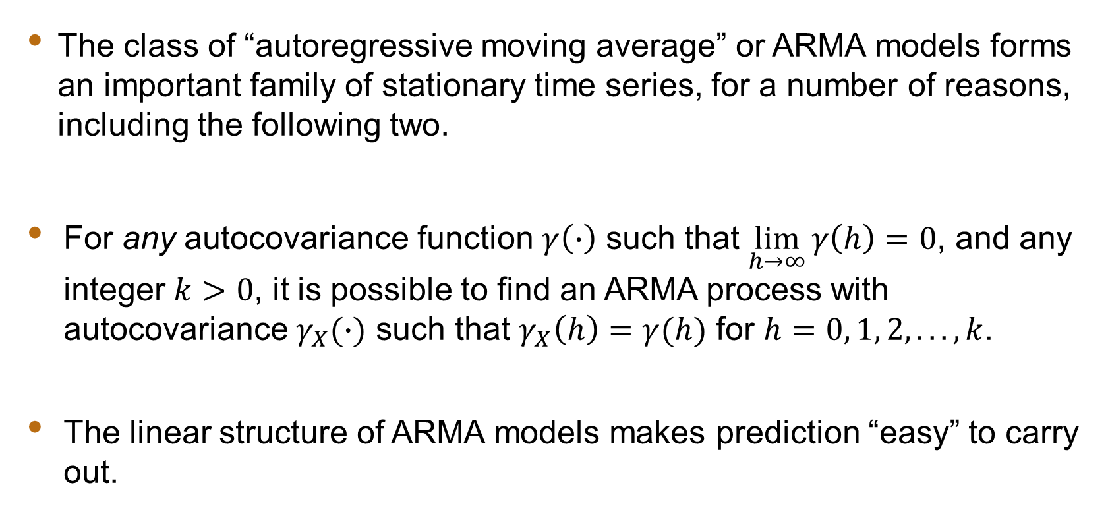
ARMA Model: General
The class of “autoregressive moving average” or ARMA models forms an important family of stationary time series, for a number of reasons, including the following two.
For any autocovariance function $γ\left(∙\right)$ such that $\lim_{h→∞}{γ\left(h\right)=0}$, and any integer $k>0$, it is possible to find an ARMA process with autocovariance $γ_{X}(∙)$ such that $γ_{X}\left(h\right)=γ(h)$ for $h=0, 1, 2, .. ., k$.
The linear structure of ARMA models makes prediction “easy” to carry out.

